Slide 1
Script Parameters
October 31, 2014
Notes:
Guidewire training materials contain Guidewire proprietary information that is subject to confidentiality and non-disclosure agreements. You agree to use the information in this manual solely for the purpose of training to implement Guidewire software solutions. You also agree not to disclose the information in this manual to third parties or copy this manual without prior written consent from Guidewire. Guidewire training may be given only by Guidewire employees or certified Guidewire partners under the appropriate agreement with Guidewire.
<number>

Slide 2
Describe the function of script parameters
Create and update script parameters
Reference script parameters
Notes:
<number>

Slide 3
Script parameter basics
Creating and referencing script parameters
Updating script parameters
Notes:
<number>

Slide 4
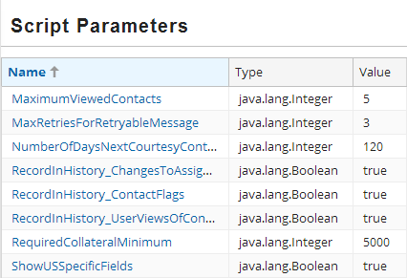
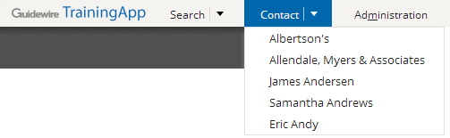
Script parameters
A script parameter is a global variable for a Guidewire application
Configuration developer defines
Reference anywhere as read-only values in Gosu code
Administrator user updates values in user interface
Example:
MaximumViewedContacts value sets the limit to number of contacts in the tab bar menu
Notes:
Script parameters allow developers to avoid hard-coded application constants for the constant may change over time and/or for when an administrator user needs to ability to change a parameter value in the Administration user interface. The result is that developers can reference script parameters in Gosu code while allowing administrator users to change the values.
There are several reasons to create global variables as script parameters: (a) you want a variable that is global in scope across the application that you can change or reset through the application interface, and/or (b) you want a variable to hold a value that you can use in any Gosu expression, and you want to change that value without editing the expression. For example, you can configure ClaimCenter script parameters to set initial reserve values for automobile claims such as auto glass damage, full body damage, or minor body damage. These initial reserve values can change from year to year.
Guideline recommends that you use Gosu class variables instead of script parameters to reference values in Gosu expressions. The exception would be if you needed the ability to change the value from the Guidewire application interface.
<number>

Slide 5

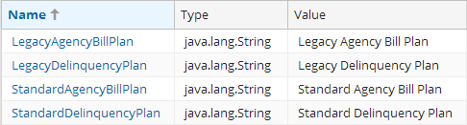

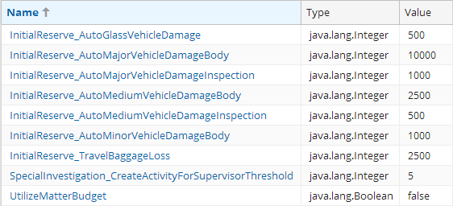


Script parameter examples
BillingCenter
Parameters for delinquency and agency bills
ClaimCenter
Parameters for initial reserves, special investigations, and functionality
PolicyCenter
Parameter for functionality for search tab
Notes:
PolicyCenter 8.0 has a single script parameter to enable a search tab.
BillingCenter 8.0uses script parameters primarily to manage values pertaining to delinquency and agency bills.
ClaimCenter 8.0 uses script parameters primarily to manage values pertaining to initial reserves.
<number>

Slide 6
File and entity
ScriptParameters.xml
ScriptParameter.eti
XML file that defines multiple parameters
Application uses only these defined parameters
Parameters values initially used and when not defined in the database
Defines script parameter instance
When editing a parameter value, administrator user creates entity instance
When defined, application uses parameter values in database, but only for parameters that exist in ScriptParameters.xml
Notes:
If a script parameter exists in the ScriptParameter.xml file but not in the Guidewire application database table for ScriptParameter, Guidewire uses the value from the ScriptParameter.xml file and stores that value to the script parameter cache. The script parameter cache is a special global cache.
Only when an Administrator user edits a script parameter value in the user interface does the Guidewire application actually create an instance of a ScriptParameter entity in the database. For a given script parameter, if the parameter value differs between the element in ScriptParameters.xml and the entity instance in the database, the Guidewire application will use the value in the database for the script parameter cache.
A Guidewire application manages script parameters in a special global cache. You can control the refresh interval for the script parameter cache with the value for the ScriptParametersRefreshIntervalSecs setting in the config.xml file.
<number>

Slide 7
Script parameter basics
Creating and referencing script parameters
Updating script parameters
Notes:
<number>

Slide 8
Steps to create a script parameter
In Guidewire Studio, open ScriptParameters.xml
Create a parameter in XML
Deploy the script parameter
Reference the script parameter
Notes:
<number>

Slide 9
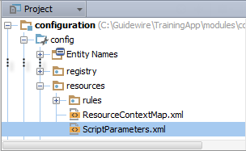
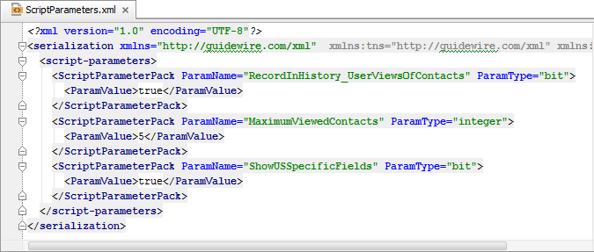
Step 1: Open ScriptParameters.xml
In Project View, select and open ScriptParameters.xml in …\config\resources\
Use the native XML editor to edit the file
Notes:
<number>

Slide 10
Step 2: Create a parameter in XML
…3 <script-prameterPack>
…16 <ScriptParameterPack ParamName="MaximumViewedContacts" ParamType="integer"> 17 <ParamValue>5</ParamValue> 18 </ScriptParameterPack> …25 <script-prameterPack>
Add a ScriptParameterPack element
Define the ParamName attribute
Define the ParamType attribute
Add the ParamValue element and an inner value
Notes:
For valid values for ParamType attribute, see the value ScriptParameterType typelist. The values are:
bit
datetime
decimal
group
integer
money
monthlyfrequency
nonnegativeinteger
nonnegativemoney
percentage
percentagedec
phone
positiveinteger
positivemoney
postalcode
risk
speed
user
varchar
weeklyfrequency
year
<number>

Slide 11
Step 3: Deploy the script parameter
Restart Server
Reload PCFs
Script Parameter read at start up
See notes about Studio
ALT+SHIFT+L
Internal debug tools enabled
Internal Tools
Reload → Reload PCF Files
ScriptParameter.xml
ScriptParameter.xml
Notes:
To force the Guidewire application to reload the script parameter global cache, you can restart the server or reload PCFs. Changes to script parameters include the deletion of an existing script parameter from the ScriptParameter.xml file or adding a new script parameter to the ScriptParameter.xml file.
You can restart the server from the bin command window (gwXX dev-stop then gwXX dev-start) or restart the server from Guidewire Studio (Run → Stop then Run 'Server' or Debug 'Server').
It is also possible to reload PCF files using the Guidewire API and/or internal server tools. The Reload PCF command can be found on the Reload page in Internal Tools. To access Internal Tools, the EnableInternalDebugTools setting in the config.xml file must be set to true. The keystroke to open the Internal Tools page is ALT+SHIFT+T. In the tab bar, select Internal Tools → Reload. On the Reload page, click the Reload PCF Files button. Both the keystroke ALT+SHIFT+L and the Reload PCF Files button call the same static method: gw.api.tools.InternalToolsUtil.reloadPCFs().
Important:
For a newly referenced script parameter in Gosu code, Guidewire Studio will show an inspection error saying that it is unable to find the named static property of the script parameter. In order for Guidewire Studio to recognize the new script parameter with dot completion, you must restart Guidewire Studio.
<number>

Slide 12
Step 4: Reference the script parameter
8 class RecentlyViewedContactUtil {
…11 static property get maximumViewedContacts(): int {
12 var value: int = 5
13 if (ScriptParameters.MaximumViewedContacts > 0) {
14 value = ScriptParameters.MaximumViewedContacts
15 }
16 return value
17 }
…56 }
Line 13: Access the script parameter directly
Line 14: Assign the script parameter to local variable if you are concerned about the value being outside of a default range
Notes:
Important:
For a newly referenced script parameter in Gosu code, Guidewire Studio will show an inspection error saying that it is unable to find the named static property of the script parameter. In order for Guidewire Studio to recognize the new script parameter with dot completion, you must restart Guidewire Studio.
In the slide example, the RecentlyViewedContactUtil is a Gosu class located at …\configuration\gsrc\trainingapp\base\RecentlyViewedContactUtil.gs.
Guidewire recommends that you use Gosu class variables instead of script parameters to reference values in Gosu expressions. The exception would be if you needed the ability to change the value from the Guidewire application interface.
You can reference a script parameter directly. However, if you are concerned about the value range for a given script parameter, then assign the script parameter directly to a local variable with a default value. In addition, if you are referencing the script parameter throughout a Gosu class, consider assigning the variable to a global class variable.
<number>

Slide 13
Script parameter basics
Creating and referencing script parameters
Updating script parameters
Notes:
<number>

Slide 14
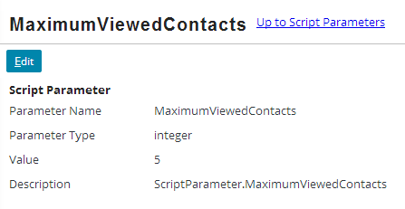
Access the script parameters
Log in as…
Administrator user
User with role that has permissions to access the Administration user interface and manage script parameters
Administration → Utilities → Script Parameters
Click the parameter name in the list view panel
Notes:
To access the script parameter:
Navigate to the Administration → Utilities → Script Parameters.
Click the name of the script parameter in the list view panel.
<number>

Slide 15
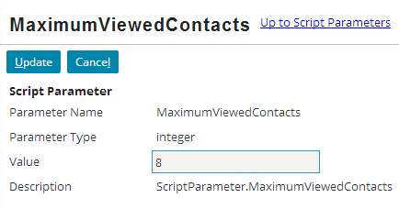
Update a script parameter value
Click Edit → Edit the Value field
Clikc Update
Value changes are immediate and global
Notes:
To update a script parameter:
Navigate to the Administration → Utilities → Script Parameters.
Click the name of the script parameter in the list view panel.
In the detail view panel, click the Edit button.
Edit the Value field.
Click Update.
Changes to a script parameter value takes effect immediately. The script parameter is added or updated in the database. The script parameter global cache is refreshed.
<number>

Slide 16
Describe the role of script parameters
Create and update script parameters
Reference script parameters
Notes:
<number>

Slide 17
What is a script parameter and an example of a script parameter?
Why use script parameters?
After you have created a script parameter, what must you do to fully deploy it?
Where can a script parameter be referenced?
How do you reference a script parameter?
How can an administrator user update a script parameters?
If a script parameter's value differs in between the ScriptParameters.xml file and the database, which value does the Guidewire application use?
Notes:
Answers
1) Script parameters act as a global variables where the variable value may change over time and therefore should not be hard-coded. Examples of Guidewire application script parameters include BillingCenter delinquency and agency bill settings and ClaimCenter initial reserve settings.
2) You want a variable that is global in scope across the application that you can change or reset through the application interface, and/or you want a variable to hold a value that you can use in any Gosu expression, and you want to change that value without editing the expression
3) You must restart the server or reload PCFS to deploy the script parameter. In order for Guidewire Studio to recognize the script parameter, you must restart studio.
4) In Gosu code you can reference a script parameter including business rules, enhancements, Gosu classes, and PCF files.
5) You reference the script parameter directly. If you are concerned about the value being outside a range or set of possible values, you can also assign the script parameter to a local variable that has a default value. If using the script parameter throughout a Gosu class or enhancement, you may also assign the script parameter to a global class variable.
6) Administrator users can access the Administration screen for the Script Parameters. In the list view panel, click the script parameter name. In the detail view panel for the script parameter, click Edit. And administrator user can edit the parameter value. Click Update.
7) The Guidewire application uses the script parameter value in the database.
<number>

Slide 18
Notes:
<number>

